Slide 1
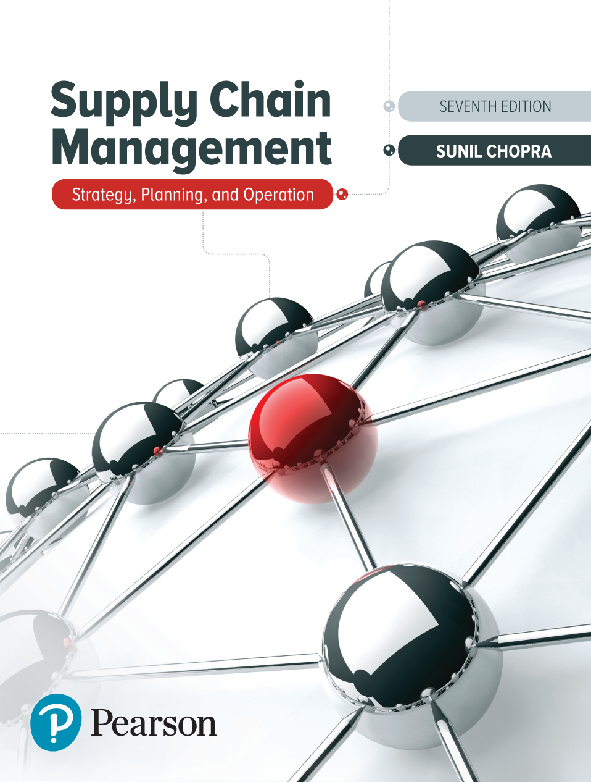
Supply Chain Management: Strategy, Planning, and Operation
Seventh Edition
Chapter 9
Sales and Operations Planning in a Supply Chain
Copyright © 2019, 2016, 2013 Pearson Education, Inc. All Rights Reserved
Notes:
If this PowerPoint presentation contains mathematical equations, you may need to check that your computer has the following installed:
1) MathType Plugin
2) Math Player (free versions available)
3) NVDA Reader (free versions available)

Slide 2
Learning Objectives
9.1 Manage supply and demand to improve synchronization in a supply chain in the face of predictable variability.
9.2 Use sales and operations planning to maximize profitability when faced with predictable variability in a supply chain.

Slide 3
Responding to Predictable Variability in a Supply Chain
Predictable variability is change in demand that can be forecasted
Can cause increased costs and decreased responsiveness in the supply chain
Two broad options
Manage supply using capacity, inventory, subcontracting, and backlogs
Manage demand using short-term price discounts and promotions

Slide 4
Managing Supply (1 of 2)
Managing capacity
Time flexibility from workforce
Use of seasonal workforce
Use of dual facilities – specialized and flexible
Use of subcontracting
Designing product flexibility into production processes

Slide 5
Managing Supply (2 of 2)
Managing inventory
Using common components across multiple products
Build inventory of high-demand or predictable-demand products

Slide 6
Inventory/Capacity Trade-Off
Leveling capacity forces inventory to build up in anticipation of seasonal variation in demand
Carrying low levels of inventory requires capacity to vary with seasonal variation in demand or enough capacity to cover peak demand during season

Slide 7
Managing Demand (1 of 4)
With promotion, three factors lead to increased demand
Market growth
Stealing share
Forward buying
Factors influencing timing of a promotion
Impact of promotion on demand
Cost of holding inventory
Cost of changing the level of capacity
Product margins

Slide 8
Managing Demand (2 of 4)
Table 9-1 Summary of Impact on Promotion Timing
Factor | Impact on Timing of Promotion/ Forward Buy
High forward buying | Favors promotion during low-demand periods
High ability steal market share | Favors promotion during peak-demand periods
High ability to increase overall market | Favors promotion during peak-demand periods
High margin | Favors promotion during peak-demand periods
Low margin | Favors promotion during low-demand periods
High manufacturer holding costs | Favors promotion during low-demand periods
High costs of changing capacity | Favors promotion during low-demand periods
High retailer holding costs | Decreases forward buying by retailer
High promotion elasticity of consumer | Decreases forward buying by retailer

Slide 9
Summary of Learning Objective 1
Companies can maximize profits by managing supply and demand to improve synchronization in a supply chain in the face of predictable variability. Supply can be managed using capacity or inventory. Companies can reduce the capacity required through the use of workforce flexibility, subcontracting, dual facilities, and product flexibility. Companies can reduce the inventory required by emphasizing common parts and building and holding products with predictable demand ahead of time. Demand can be managed using pricing and promotion decisions because the timing of promotions has a tremendous impact on demand. Therefore, using pricing to shape demand in concert with supply planning can help improve supply chain profits.

Slide 10
Sales and Operations Planning at Red Tomato
Table 9-2 Costs for Red Tomato and Green Thumb
Item | Cost
Material cost | $10/unit
Inventory holding cost | $2/unit/month
Marginal cost of stockout/backlog | $5/unit/month
Hiring and training costs | $300/worker
Layoff cost | $500/worker
Labor hours required | 4/unit
Regular time cost | $4/hour
Overtime cost | $6/hour
Cost of subcontracting | $30/unit

Slide 11
Managing Demand (3 of 4)
Figure 9-1 Base Case Aggregate Plan for Red Tomato and Green Thumb

Slide 12
Managing Demand (4 of 4)
Total cost over planning horizon = $422,660
Revenue over planning horizon = $640,000
Profit over planning horizon = $217,340

Slide 13
When to Promote
Is it more effective to promote during the peak period of off-peak?
Analyze the impact of a promotion on demand and the resulting optimal aggregate plan

Slide 14
Promotion in January (1 of 2)
Figure 9-2 Optimal Aggregate Plan When Discounting Price in January to $39

Slide 15
Promotion in January (2 of 2)
Total cost over planning horizon = $422,080
Revenue over planning horizon = $643,400
Profit over planning horizon = $221,320
Lower seasonal inventory
A somewhat lower total cost
A higher total profit

Slide 16
Promotion in April (1 of 2)
Figure 9-3 Optimal Aggregate Plan When Discounting Price in April to $39

Slide 17
Promotion in April (2 of 2)
Total cost over planning horizon = $438,920
Revenue over planning horizon = $650,140
Profit over planning horizon = $211,220
Higher seasonal inventory
A somewhat higher total cost
A slightly smaller total profit

Slide 18
Discount Leads to Large Increase in Consumption (1 of 4)
Promotion in January
Figure 9-4 Optimal Aggregate Plan When Discounting Price in January to $39 with Large Increase in Demand

Slide 19
Discount Leads to Large Increase in Consumption (2 of 4)
Total cost over planning horizon = $456,880
Revenue over planning horizon = $699,560
Profit over planning horizon = $242,680
Higher total profit than base case

Slide 20
Discount Leads to Large Increase in Consumption (3 of 4)
Promotion in April
Figure 9-5 Optimal Aggregate Plan When Discounting Price in April to $39 with Large Increase in Demand

Slide 21
Discount Leads to Large Increase in Consumption (4 of 4)
Total cost over planning horizon = $536,200
Revenue over planning horizon = $783,520
Profit over planning horizon = $247,320
Much higher level of seasonal inventory
Uses more stockouts and subcontracting
Revenues increase
Overall profits higher

Slide 22
Supply Chain Performance
Table 9-3 Supply Chain Performance Under Different Scenarios
Regular Price | Promotion Price | Promotion Period | Percentage of Increase in Demand | Percentage of Forward Buy | Profit | Average Inventory
$40 | $40 | NA | NA | NA | $217,340 | 875
$40 | $39 | January | 10% | 20% | $221,320 | 515
$40 | $39 | April | 10% | 20% | $211,220 | 932
$40 | $39 | January | 100% | 20% | $242,680 | 232
$40 | $39 | April | 100% | 20% | $247,320 | 1,492
$31 | $31 | NA | NA | NA | $73,340 | 875
$31 | $30 | January | 100% | 20% | $84,280 | 232
$31 | $30 | April | 100% | 20% | $69,120 | 1,492

Slide 23
Conclusions on Promotion (1 of 3)
Average inventory increases if a promotion is run during the peak period and decreases if the promotion is run during the off-peak period
Promoting during a peak-demand month may decrease overall profitability if there is a small increase in consumption and a significant fraction of the demand increase results from a forward buy

Slide 24
Conclusions on Promotion (2 of 3)
As the consumption increase from discounting grows and forward buying becomes a smaller fraction of the demand increase from a promotion, it is more profitable to promote during the peak period
As the product margin declines, promoting during the peak-demand period becomes less profitable

Slide 25
Conclusions on Promotion (3 of 3)
When faced with seasonal demand, use combination of pricing and production and inventory to improve profitability
Entire supply chain must work toward one goal of maximizing profitability
High-level support within an organization is necessary
Early warning alerts should be built into the S & O P process

Slide 26
Summary of Learning Objective 2
To handle predictable variability in a profit-maximizing manner, supply chains must coordinate the management of both supply and demand. This requires coordinated planning across all stages of the supply chain to select pricing and promotion plans and aggregate plans that maximize supply chain profit. Sales and operations planning allows a supply chain to coordinate the planning of pricing and promotions along with the planning of production to maximize profits. To achieve coordination in practice, it is important that the S & O P process be owned by a senior leader within the supply chain.

Slide 27
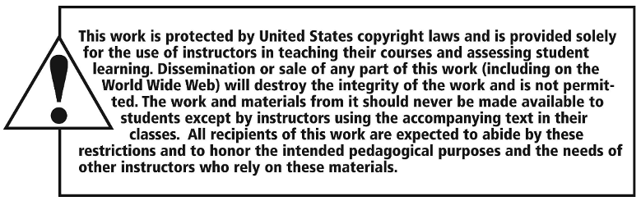
Copyright

